Slide 1
International Trade and Migration
Lorenzo Caliendo
Yale University
February, 2023

Slide 2
Session description
The Module will introduce participants to new ideas, tools, and frameworks based on recent academic research on international trade and migration.
Participation and active discussion during the sessions are expected.
The main takeaways are: why countries trade? understand what are the recent findings in terms of who gains and losses from trade and migration?

Slide 3
Yale’s Mission Statement
Yale is committed to improving the world today and for future generations through outstanding research and scholarship, education, preservation, and practice. Yale educates aspiring leaders worldwide who serve all sectors of society. We carry out this mission through the free exchange of ideas in an ethical, interdependent, and diverse community of faculty, staff, students, and alumni.

Slide 4
Let’s get started
Today’s goals:
Global view of trade
General patterns in the data
The importance of understanding trade policy
The importance of distance

Slide 5
World Trade vs GDP – The Long View
FIGURE 1. WORLD TRADE (EXPORTS + IMPORTS) AS PERCENT OF WORLD GDP. 1870-2020
Sources: Klasing and Milionis (2014) for 1870-1949 (in blue). Penn World Tables for 1950-2017 (in red), and World Bank for 1960-2020 (in green).
Notes:
Here’s another view. Exports and imports as a share of US GNP
Another thing to note: Trade as a share of US GDP is still about 10%. Some countries is extremely large—Does anyone know which countries have among the highest share of trade as share of GDP? Exceeding 100%?

Slide 6
Over the last 30 years, the World has experienced a series of unprecedented events
Cumulative Number of RTAs in force went from 82 in year 2000 to 355 today
China joins the WTO
Great Recession
Brexit – renegotiation NAFTA, TPP
US-China trade war
COVID-19
Russian invasion to Ukraine

Slide 7
Over the last 30 years, the World has experienced a series of unprecedented events
Recent destabilizing events, have generated uncertainty and weakened trade growth
Geo-political motives seem to be dominating trade policy

Slide 8
US-CHINA
Trade War
China joins WTO
COVID-19
Great Recession
World

Slide 9
World

Slide 10
World

Slide 11
China
World

Slide 12
China
World
India

Slide 13
China
World
India

Slide 14
China
Korea,Rep.
World
India

Slide 15
China
Korea,Rep.
World
India

Slide 16
China
Korea,Rep.
World
India
Vietnam

Slide 17
The world has become more open!
This phenomenon has relocated industries/ firms and labor across countries
Openness has resulted in aggregate welfare gains and had distributional consequences
Shown by several academic studies
While trade openness is historically high, over the last 15 years trade openness stagnated

Slide 18
Value chains have become global!

Slide 19
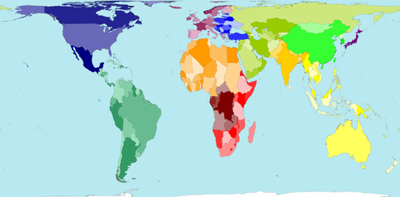
Map of the world
Sources: http://www.worldmapper.org/, wikipedia
Notes:
192 countries in UN + Vatican City + Taiwan

Slide 20
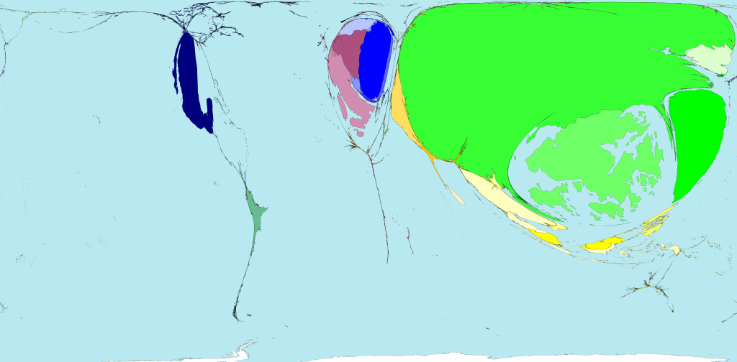
Toy exports
Sources: http://www.worldmapper.org/

Slide 21
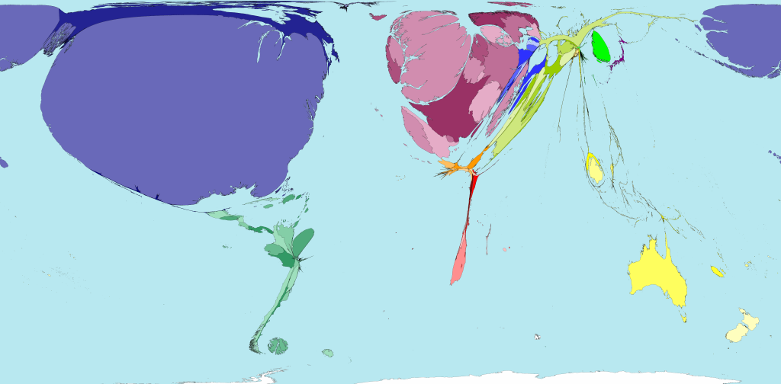
Toy imports
Sources: http://www.worldmapper.org/

Slide 22
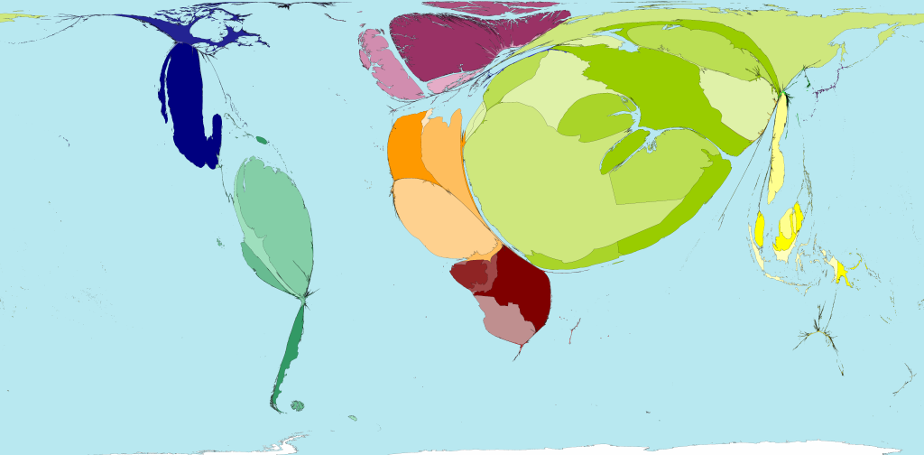
Crude petroleum exports
Sources: http://www.worldmapper.org/

Slide 23
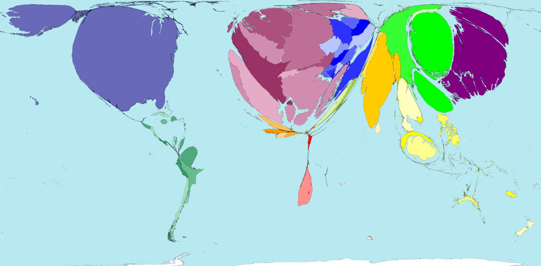
Crude petroleum imports
Sources: http://www.worldmapper.org/

Slide 24
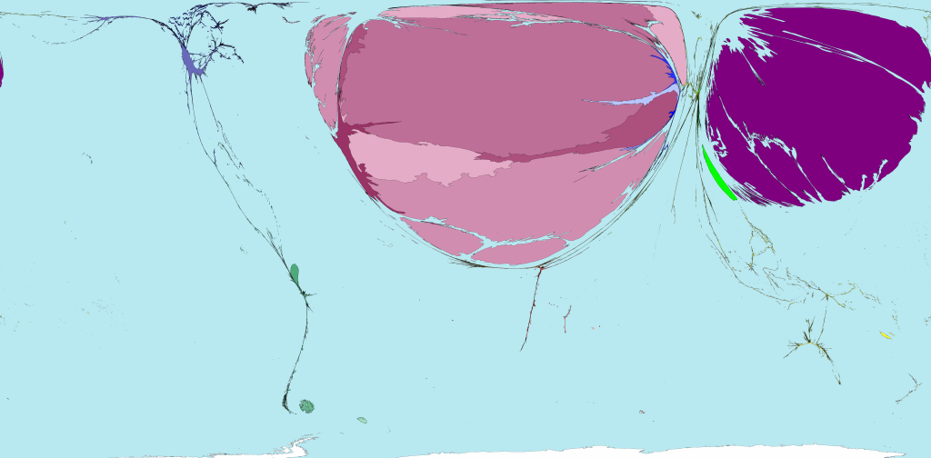
Machines exports
Sources: http://www.worldmapper.org/

Slide 25
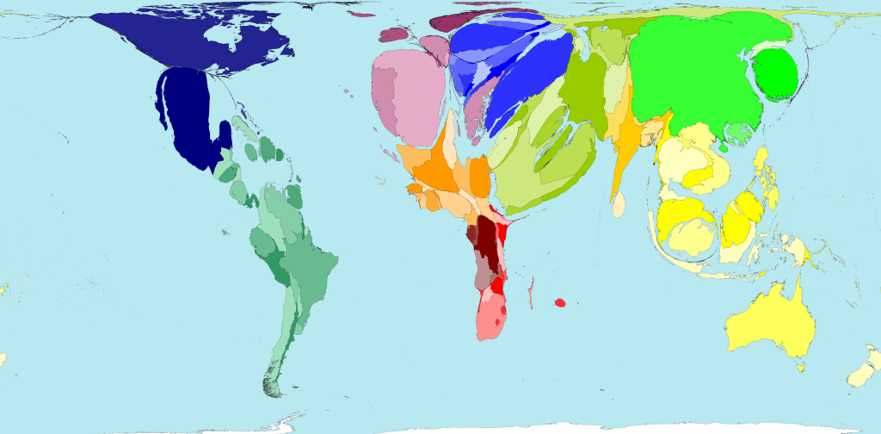
Machines imports
Sources: http://www.worldmapper.org/

Slide 26
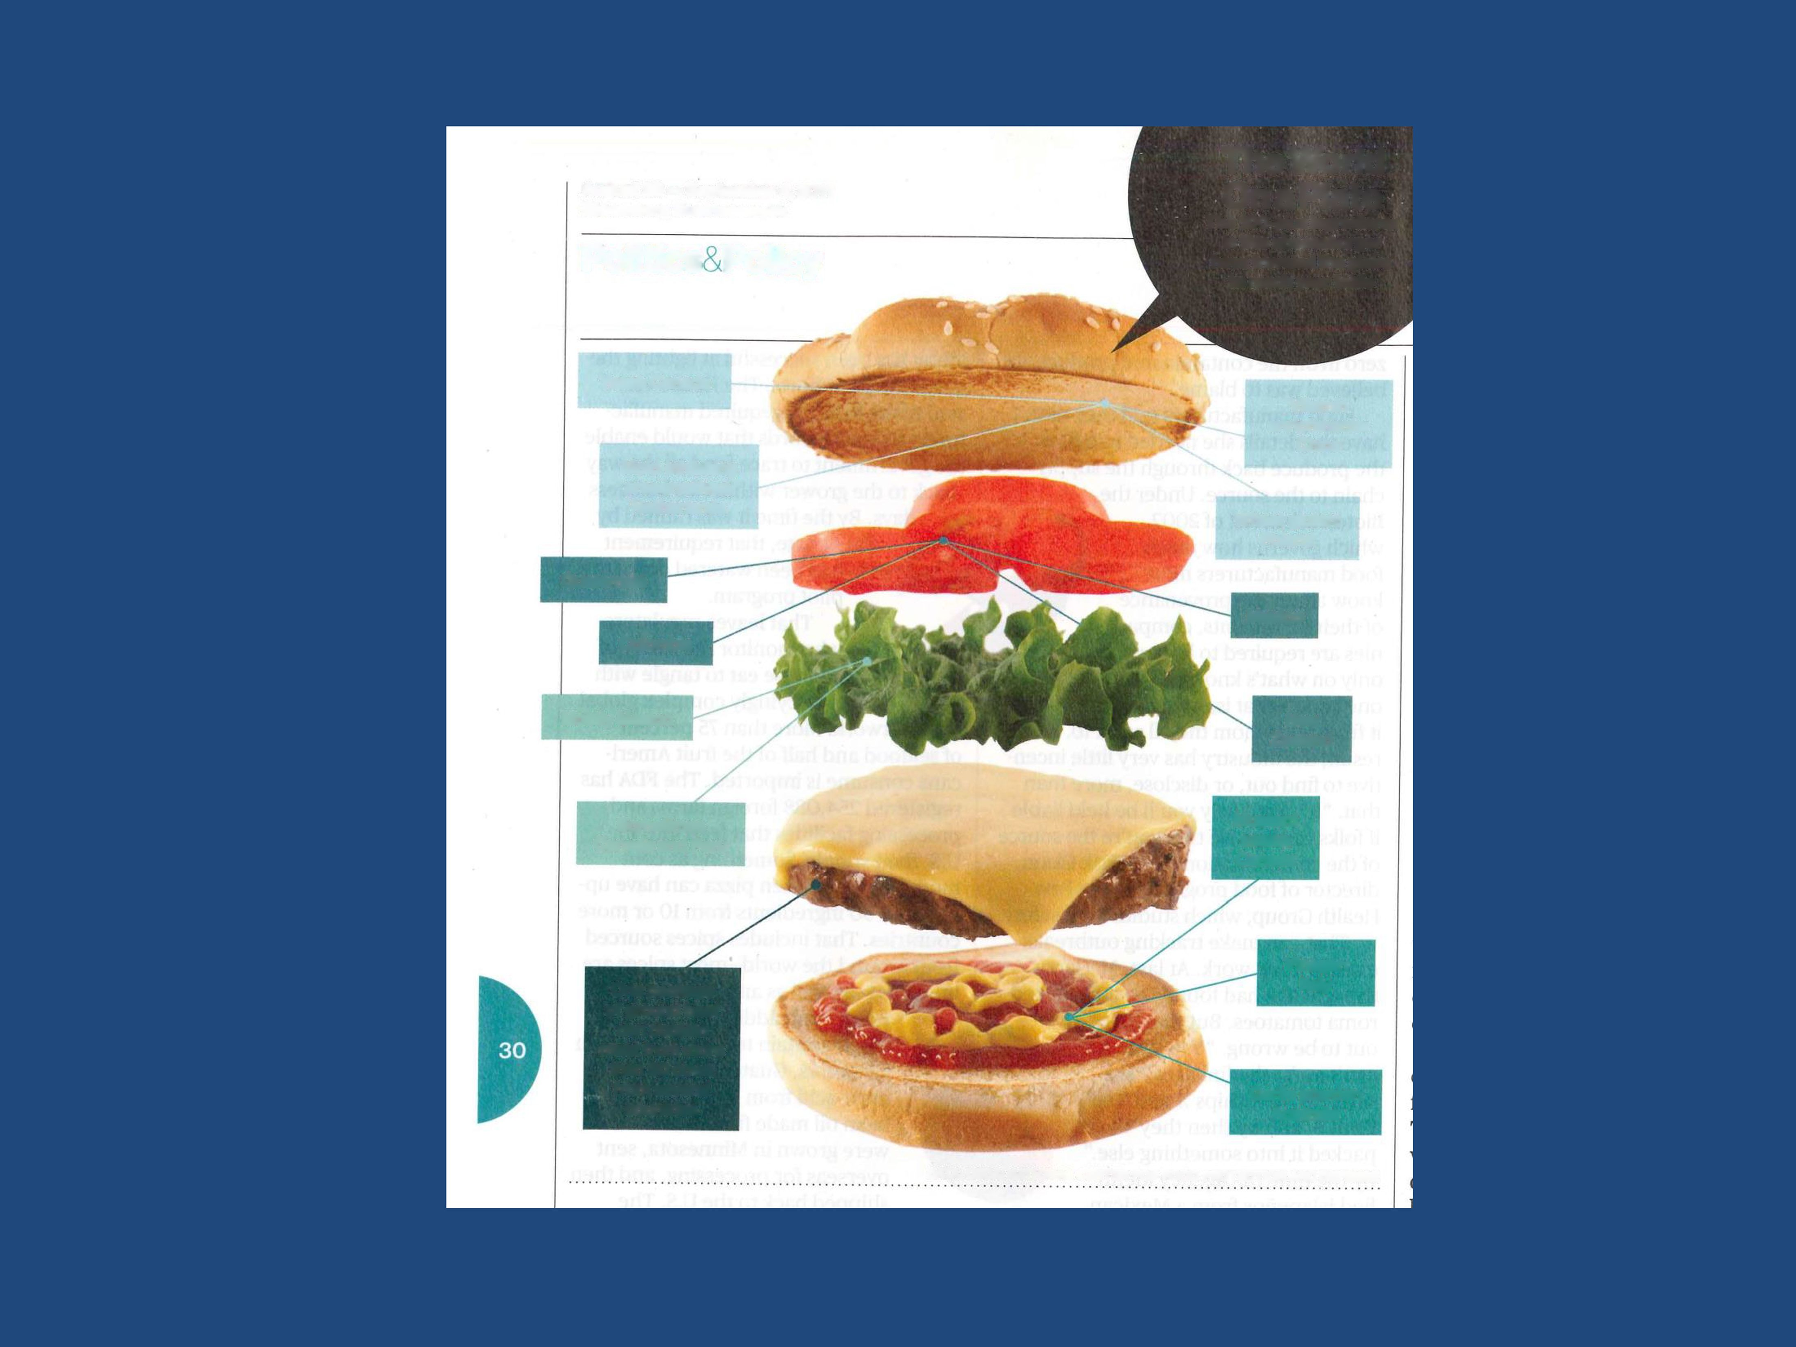
The World Ona Plate
August 29 — September 4,2011
Bloomberg Businessweek
The 100-plus ingredients in this cheeseburger have traveled the globe to reach your table
Politics & Policy
Yeast: Canada
Vitamin enrichments: China
Mold-inhibiting preservatives: Netherlands
Wheat gluten: Poland
Guatemala
Mexico
Colombia
Mostly Mexico
New Zealand
Sometimes Canada and Peru
Mustard seeds: Canada
One package of ground beef can contain meat from more than 50 cows from several countries
Vinegar: Italy
Garlic powder: Australia
DATA: USDA; NATIONAL CENTER FOR FOOD PROTECTION AND DEFENSE

Slide 27
Value chains have become global!
This has resulted in economic gains
Countries that are central in the global supply chain have been gaining power
Example:
Russian invasion to Ukraine
Russia over the years has become one of the main suppliers of essential inputs (like Gas and Oil)
Countries not willing to completely ban imports from Russia
No rules-based approach to sanction Russia

Slide 28
Global effects of a ban to exports of Russia's Oil and Gas Caliendo and Parro (2022)
Figure 1 Change in Real Income (%)
Real world income effect (excluding Russia) = -0.008%

Slide 29
Why do countries trade?
Differences in technologies
Ricardian model of trade
Differences in endowments/resources
Heckscher Ohlin model of trade
Increasing returns/ variety
Krugman model of trade
Will be great if you could read about these three theories online before we meet.

Slide 30
International vs “Domestic” Economics
How is doing business internationally different from doing business within countries?
Distance!

Slide 31
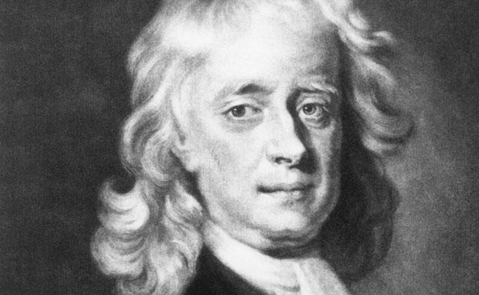
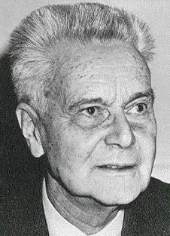
Gravity Head and Mayer 2013
One of strongest empirical relationships in economics is known as “gravity”
From physics (Newton 1687)
The attraction between two objects declines with the distance between them, and increases with their mass
From economics (Tinbergen 1962)
Commercial trade between two countries declines with the distance between them and increases with their economic size
Isaac Newton
1642-1727
Jan Tinbergen
1903-94

Slide 32
Estimating Gravity
Gravity is usually estimated in a very simple regression of bilateral trade between countries c and d on distance and market size
X_{cd} = (GDP_{c} * GDP_{d}) / Distance_{cd}
ln(X_{cd}) = αln(GDP_{c}) + βln(GDP_{d}) + γln(Distance_{cd})

Slide 33
Trade and Market Size
Economic Gravity
Log Bilateral Trade
Log Total Market Size
Source: Data from Mayer, Head and Ries (2010).

Slide 34
Trade and Distance
Given all the advances in technology and policies to facilitate globalization that have occurred since 1950, how do you think the relationship between trade and distance looks today?
Economic Gravity
Log Bilateral Trade
Elasticity: a 1% increase in distance reduces trade by roughly 1%
Log Distance
Source: Data from Mayer, Head and Ries (2010). Trade flows conditional on GDP.

Slide 35
Trade and Distance
Economic Gravity
Log Bilateral Trade
Log Distance
Source: Data from Mayer, Head and Ries (2010). Trade flows conditional on GDP.

Slide 36
Trade and Distance
Economic Gravity
Log Bilateral Trade
Log Distance
Source: Data from Mayer, Head and Ries (2010). Trade flows conditional on GDP.

Slide 37
Trade and Distance
Economic Gravity
Log Bilateral Trade
Log Distance
Source: Data from Mayer, Head and Ries (2010). Trade flows conditional on GDP.

Slide 38
Trade and Distance
Economic Gravity
Log Bilateral Trade
Log Distance
Source: Data from Mayer, Head and Ries (2010). Trade flows conditional on GDP.

Slide 39
Trade and Distance
Economic Gravity
Log Bilateral Trade
Log Distance
Source: Data from Mayer, Head and Ries (2010). Trade flows conditional on GDP.

Slide 40
Trade and Distance
Economic Gravity
Log Bilateral Trade
Log Distance
Source: Data from Mayer, Head and Ries (2010). Trade flows conditional on GDP.

Slide 41
Trade and Distance
Economic Gravity
Log Bilateral Trade
Log Distance
Source: Data from Mayer, Head and Ries (2010). Trade flows conditional on GDP.

Slide 42
Trade and Distance
Economic Gravity
2006, Original 1950 Trading Pairs
Log Bilateral Trade
Log Distance
Source: Data from Mayer, Head and Ries (2010). Trade flows conditional on GDP.

Slide 43
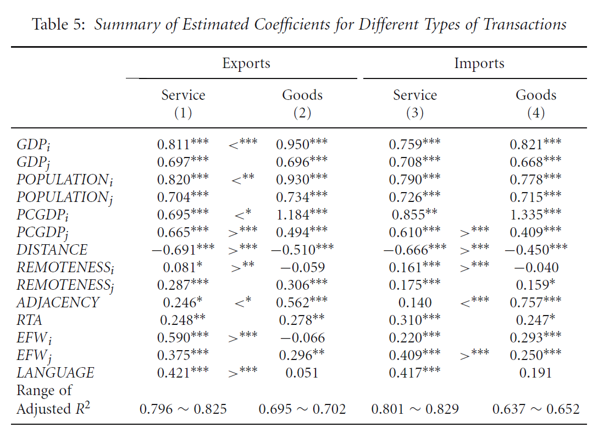
Gravity in Services Trade…
Remarkably, trade in services is also impeded by distance!
So does internet surfing!
Blume and Goldfarb (2005) show that controlling for language, income, etc., Americans are more likely to visit websites from nearby countries
Games, music etc. elasticity is 3.25%
Software: no effect
Table 5: Summary of Estimated Coefficients for Different Types of Transactions
 | Exports |  |  | Imports
 | Service (1) | Goods (2) |  | Service (3) | Goods (4)
GDPi | 0.811*** | <*** | 0.950*** | 0.759*** |  | 0.821***
GDPi | 0.697*** |  | 0.696*** | 0.708*** |  | 0.668***
POPULATIONi | 0.820*** | <** | 0.930*** | 0.790*** |  | 0.778***
POPULATIONi | 0.704*** |  | 0.734*** | 0.726*** |  | 0.715***
PCGDPi | 0.695*** | <* | 1.184*** | 0.855** |  | 1.335***
PCGDPi | 0.665*** | >*** | 0.494*** | 0.610*** | >*** | 0.409***
DISTANCE | -0.691*** | >*** | -0.510*** | -0.666*** | >*** | -0.450***
REMOTENESSi | 0.081* | >** | -0.059 | 0.161*** | >*** | -0.040
REMOTENESSi | 0.287*** |  | 0.306*** | 0.175*** |  | 0.159*
ADJACENCY | 0.246* | <* | 0.562*** | 0.140 | <*** | 0.757***
RTA | 0.248** |  | 0.278** | 0.310*** |  | 0.247*
EFWi | 0.590*** | >*** | -0.066 | 0.220*** |  | 0.293***
EFWi | 0.375*** |  | 0.296** | 0.409*** | >*** | 0.250***
LANGUAGE | 0.421*** | >*** | 0.051 | 0.417*** |  | 0.191
Range of
Adjusted R² | 0.796 ~ 0.825 |  | 0.695 ~ 0.702 | 0.801 ~ 0.829 | 0.637 ~ 0.652
Source: Kumura and Lee (2006)

Slide 44
Four Dimensions of Distance (Ghemawat 2001)
Geographic | Administrative | Cultural | Economic
Physical Distance | Colonial Ties | Language | Endowments
Common Borders | Regulation/ Legal System | Ethnicity | Market Size
Access to Ports | Hostilities | Religion | FX Volatility
Climate | Currency Regime | Norms | Infrastructure
 | Trade Barriers

Slide 45
Take aways
The world has become more open
Over the las 15 years, openness has stagnated
Value chains have become global
Distance is one of the most important determinants of trade costs (for goods and services)

Slide 46
Thank you!

